Slide 1


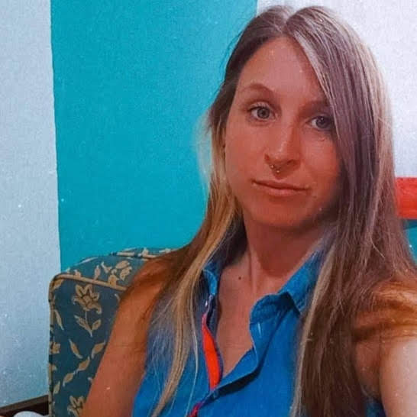


Bettina Sommer
SELECTED EXPERIENCE
ROBOTICS LATAM @ Metals & Mining COMPANY, Chile.
Role Title: Support & RPA Developer
Bot development and deployment for finance and accounting processes.
Automation Anywhere 360 with SAP
ROBOTICS LATAM @ Bank COMPANY, Chile.
Role Title: Support & RPA Developer
Bot development and deployment for internal Business Process Outsourcing.
Automation Anywhere Migration
Automation Anywhere 360
ROBOTICS LATAM @ Metals & Mining COMPANY, Chile.
Role Title: Support & RPA Developer
Bot development and deployment for finance and accounting processes.
Automation Anywhere Migration
ROBOTICS LATAM @ Metals & Mining COMPANY, Chile.
Role Title: Support & RPA Developer
Bot development and deployment for finance and accounting processes.
Automation v11
Data Engineering Associate
Technology / Data & AI
Bettina.a.sommer@accenture.com
Buenos Aires, Argentina
PROFESSIONAL BACKGROUND
AREA OF EXPERTISE
+2 years working in Accenture Argentina, as a Data Engineering Associate, providing automation solutions for clients in different industries with Automation Anywhere 360 up to now.
HARD/SOFT SKILLS & TOOLS
Dev: Python/C/VBA
DB: SQL
RPA: Automation Anywhere/Automation Anywhere IQBot/Microsoft Power Platform Fundamentals
Others: Trained in UiPath Developer Advanced.
EDUCATION
University Technician in Computer Science in UNGS (still in progress)
Automation Anywhere 360 (Certified 2021)
Microsoft Power Platform PL-900 (Certified 2023)
LANGUAGES
INDUSTRY
English (C1)
Spanish (Native)
Metals and Mining – IT Services
Bank – IT Services
Accenture

